Slide 1
Array
Prepared by:
Jyotsnarani Tripathy

Slide 2
Arrays
An array is a collection of data elements that are of the same type (e.g., a collection of integers, collection of characters, collection of doubles).
An array is a collection of elements of the same type that are referenced by a common name.
Compared to the basic data type (int, float & char) it is an aggregate or derived data type.
All the elements of an array occupy a set of contiguous memory locations

Slide 3
Array Applications
Given a list of test scores, determine the maximum and minimum scores.
Read in a list of student names and rearrange them in alphabetical order (sorting).
Given the height measurements of students in a class, output the names of those students who are taller than average

Slide 4
Arrays
Can you imagine how long we have to write the declaration part by using normal variable declaration?
  int main()
  {
    int studMark1, studMark2, studMark3, studMark4, …, …, studMark998, stuMark999, studMark1000;
    …
    …
    return 0;
  }

Slide 5
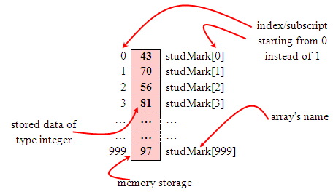
Cont..
By using an array, we just declare like this,
int studMark[1000];
This will reserve 1000 contiguous memory locations for storing the students’ marks.
Graphically, this can be depicted as in the following figure.

Slide 6
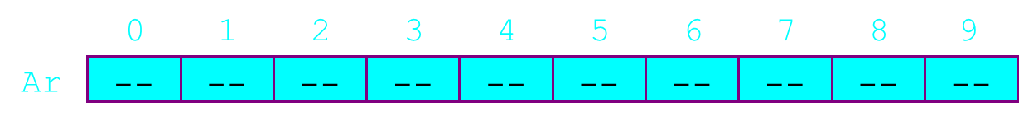
Array Declaration
int Ar[10];

Slide 7
Cont..
Declaring arrays - specify:
Name
Type of array
Number of elements
Examples
int c[ 10 ];
float hi[ 3284 ];
Declaring multiple arrays of same type
Similar format as other variables
Example
int b[ 100 ], x[ 27 ];

Slide 8
Examples Using Arrays
Initializers
      int n[ 5 ] = { 1, 2, 3, 4, 5 };
  If not enough initializers, rightmost elements become 0
  If too many initializers, a syntax error is generated
      int n[ 5 ] = { 0 }
  Sets all the elements to 0
If size omitted, the initializers determine it
      int n[] = { 1, 2, 3, 4, 5 };
  5 initializers, therefore n is a 5 element array

Slide 9
Example 1: Array Input/Output
// Program to take 5 values from the user and store them in an array
// Print the elements stored in the array
#include <stdio.h>
int main() {
int values[5];
printf("Enter 5 integers: ");

Slide 10
Cont…
// taking input and storing it in an array
for(int i = 0; i < 5; ++i) {
scanf("%d", &values[i]);
}
printf("Displaying integers: ");
// printing elements of an array
for(int i = 0; i < 5; ++i) {
printf("%d\n", values[i]);
}
return 0;
}

Slide 11
Example 2: Calculate Average
// Program to find the average of n numbers using arrays
#include <stdio.h>
int main()
{
int marks[10], i, n, sum = 0, average;
printf("Enter number of elements: ");
scanf("%d", &n);
for(i=0; i<n; ++i)
{
printf("Enter number%d: ",i+1);

Slide 12
Cont..
scanf("%d", &marks[i]);
// adding integers entered by the user to the sum variable
sum += marks[i];
}
average = sum/n;
printf("Average = %d", average);
return 0;
}

Slide 13
Multidimensional Arrays
In C programming, you can create an array of arrays. These arrays are known as multidimensional arrays. For example,
float x[3][4];
Here, x is a two-dimensional (2d) array. The array can hold 12 elements. You can think the array as a table with 3 rows and each row has 4 columns.

Slide 14
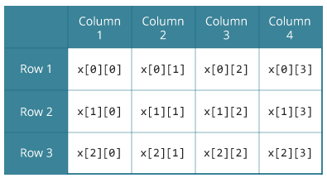

Slide 15
Cont..
Similarly, you can declare a three-dimensional (3d) array. For example,
float y[2][4][3];
Here, the array y can hold 24 elements.

Slide 16
Initialization of a 2d array
// Different ways to initialize two-dimensional array
int c[2][3] = {{1, 3, 0}, {-1, 5, 9}};
int c[][3] = {{1, 3, 0}, {-1, 5, 9}};
int c[2][3] = {1, 3, 0, -1, 5, 9};

Slide 17
Cont..
You can initialize a three-dimensional array in a similar way like a two-dimensional array. Here's an example,
int test[2][3][4] = {
{{3, 4, 2, 3}, {0, -3, 9, 11}, {23, 12, 23, 2}},
{{13, 4, 56, 3}, {5, 9, 3, 5}, {3, 1, 4, 9}}};

Slide 18
Sum of two matrices
// C program to find the sum of two matrices of order 2*2
#include <stdio.h>
int main()
{
float a[2][2], b[2][2], result[2][2];
// Taking input using nested for loop
printf("Enter elements of 1st matrix\n");
for (int i = 0; i < 2; ++i)
for (int j = 0; j < 2; ++j)
{
printf("Enter a%d%d: ", i + 1, j + 1);
scanf("%f", &a[i][j]);
}

Slide 19
// Taking input using nested for loop
printf("Enter elements of 2nd matrix\n");
for (int i = 0; i < 2; ++i)for (int j = 0; j < 2; ++j)
{
printf("Enter b%d%d: ", i + 1, j + 1);
scanf("%f", &b[i][j]);
}
// adding corresponding elements of two arrays
for (int i = 0; i < 2; ++i)
for (int j = 0; j < 2; ++j)
{

Slide 20
Cont…
result[i][j] = a[i][j] + b[i][j];
}
// Displaying the sum
printf("\nSum Of Matrix:");
for (int i = 0; i < 2; ++i)
for (int j = 0; j < 2; ++j)
{
printf("%.1f\t", result[i][j]);
if (j == 1)
printf("\n");
}
return 0;
}

Slide 21
Matrix multiplication
#include <stdio.h>
int main()
{
int m, n, p, q, c, d, k, sum = 0;
int first[10][10], second[10][10], multiply[10][10];
printf("Enter number of rows and columns of first matrix\n");
scanf("%d%d", &m, &n);
printf("Enter elements of first matrix\n");

Slide 22
Cont..
for (c = 0; c < m; c++)
for (d = 0; d < n; d++)
scanf("%d", &first[c][d]);
printf("Enter number of rows and columns of second matrix\n");
scanf("%d%d", &p, &q);
if (n != p)
printf("The multiplication isn't possible.\n");
else
{
printf("Enter elements of second matrix\n");

Slide 23
Cont..
for (c = 0; c < p; c++)
for (d = 0; d < q; d++)
scanf("%d", &second[c][d]);
for (c = 0; c < m; c++)
{
for (d = 0; d < q; d++)
{
for (k = 0; k < p; k++)
{
sum = sum + first[c][k]*second[k][d];
}
multiply[c][d] = sum;
sum = 0;
}
}

Slide 24
Cont..
printf("Product of the matrices:\n");
for (c = 0; c < m; c++) {
for (d = 0; d < q; d++)
printf("%d\t", multiply[c][d]);
printf("\n");
}
}
return 0;
}

Slide 25
#include <stdio.h>
void main()
{
int arr1[10][10],i,j,n; float determinant=0; printf("\n\nDisplay the upper triangular of a given matrix :\n");
printf("----------------------------------------------\n"); printf("Input the size of the square matrix : "); scanf("%d", &n);
printf("Input elements in the first matrix :\n"); for(i=0;i<n;i++)

